Slide 1
Final Project
Front-End Web Development
DiBimbing – Batch 19
Rama Davana

Slide 2
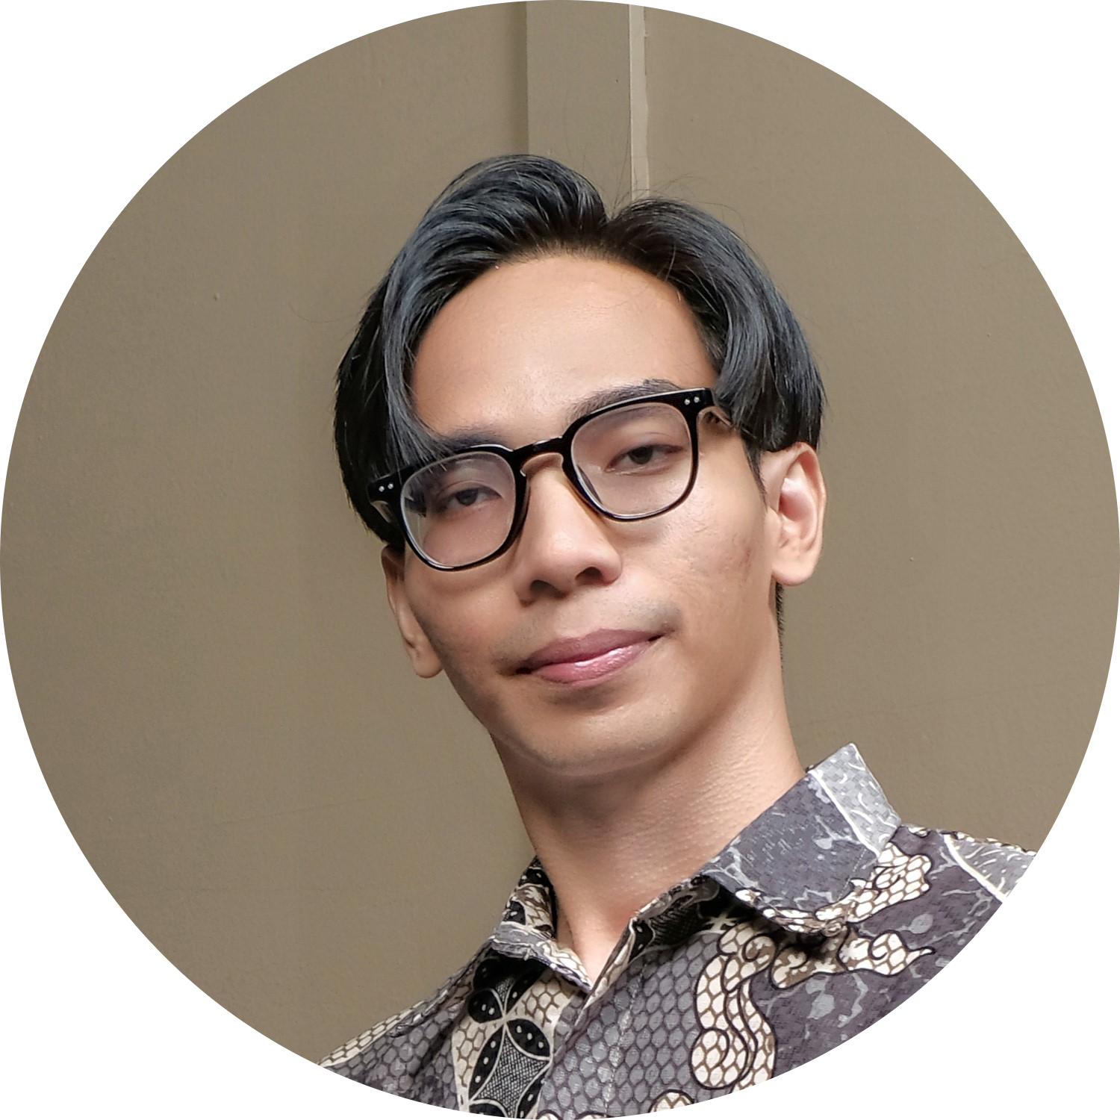
Writer’s Background
Nama : Rama Davana
Pendidikan:
Universitas Gunadarma (2019 – 2023)
S1 Ilmu Komputer
Sistem Informasi
Dibimbing.id (2024 – Present)
Front-End Web Development (Batch-19)
Domisili : Tangerang
Usia : 23 Tahun
“Dibilang freshgraduate, udah gak fresh-fresh banget sih..”

Slide 3


Background
“Trip” – perjalanan, petualangan, dan eksplorasi
“Nest” – sarang, tempat berlindung, atau rumah yang nyaman
Nama "TripNest" dipilih dengan penuh pertimbangan untuk mencerminkan visi dan tujuan dari aplikasi ini sebagai sahabat terbaik dalam merencanakan perjalanan.
Traveling telah menjadi bagian penting dalam kehidupan manusia, memberikan peluang untuk eksplorasi, relaksasi, dan pengalaman baru. Namun, planning & booking aktivitas travel maupun akomodasi sering kali terasa rumit, terutama dengan banyaknya pilihan yang tersedia.
“Recognizing the need for a seamless and user-friendly solution, TripNest was created to redefine how people plan their journeys.”
- TripNest CEO, Rama Davana

Slide 4


App Brief
Simplified Browsing and Booking
TripNest mengadopsi Browse-First Approach yang memungkinkan pengguna menjelajahi konten tanpa harus register atau login terlebih dahulu.
Comprehensive Role Management
Guest users – Public Content only
Registered users – Doing transaction activities
Admin users – Manage CRUD on website
Cross-Device Compatibility – Responsive
Desktop
Tablet
Mobile

Slide 5



Technology
v3.4.1
TailwindCSS
(Styling)
v15.0.3
Next.js
(Pages Router)
v19.0.0
React.js
(JavaScript/JSX)

Slide 6





Key Features
User Security
Authentication System
Secure login and registration system
Content Display
Dynamic Categories and Activities
Marketing & Engagement
Promotions & Discounts
Special deals to make traveling more affordable
Updated in real-time, ensuring relevant content.
Payment & Transaction
Multiple Payment Method
For seamless and flexible transactions
Administrative & Management
Admin Dashboard
Exclusive tools for managing content and monitoring activities

Slide 7
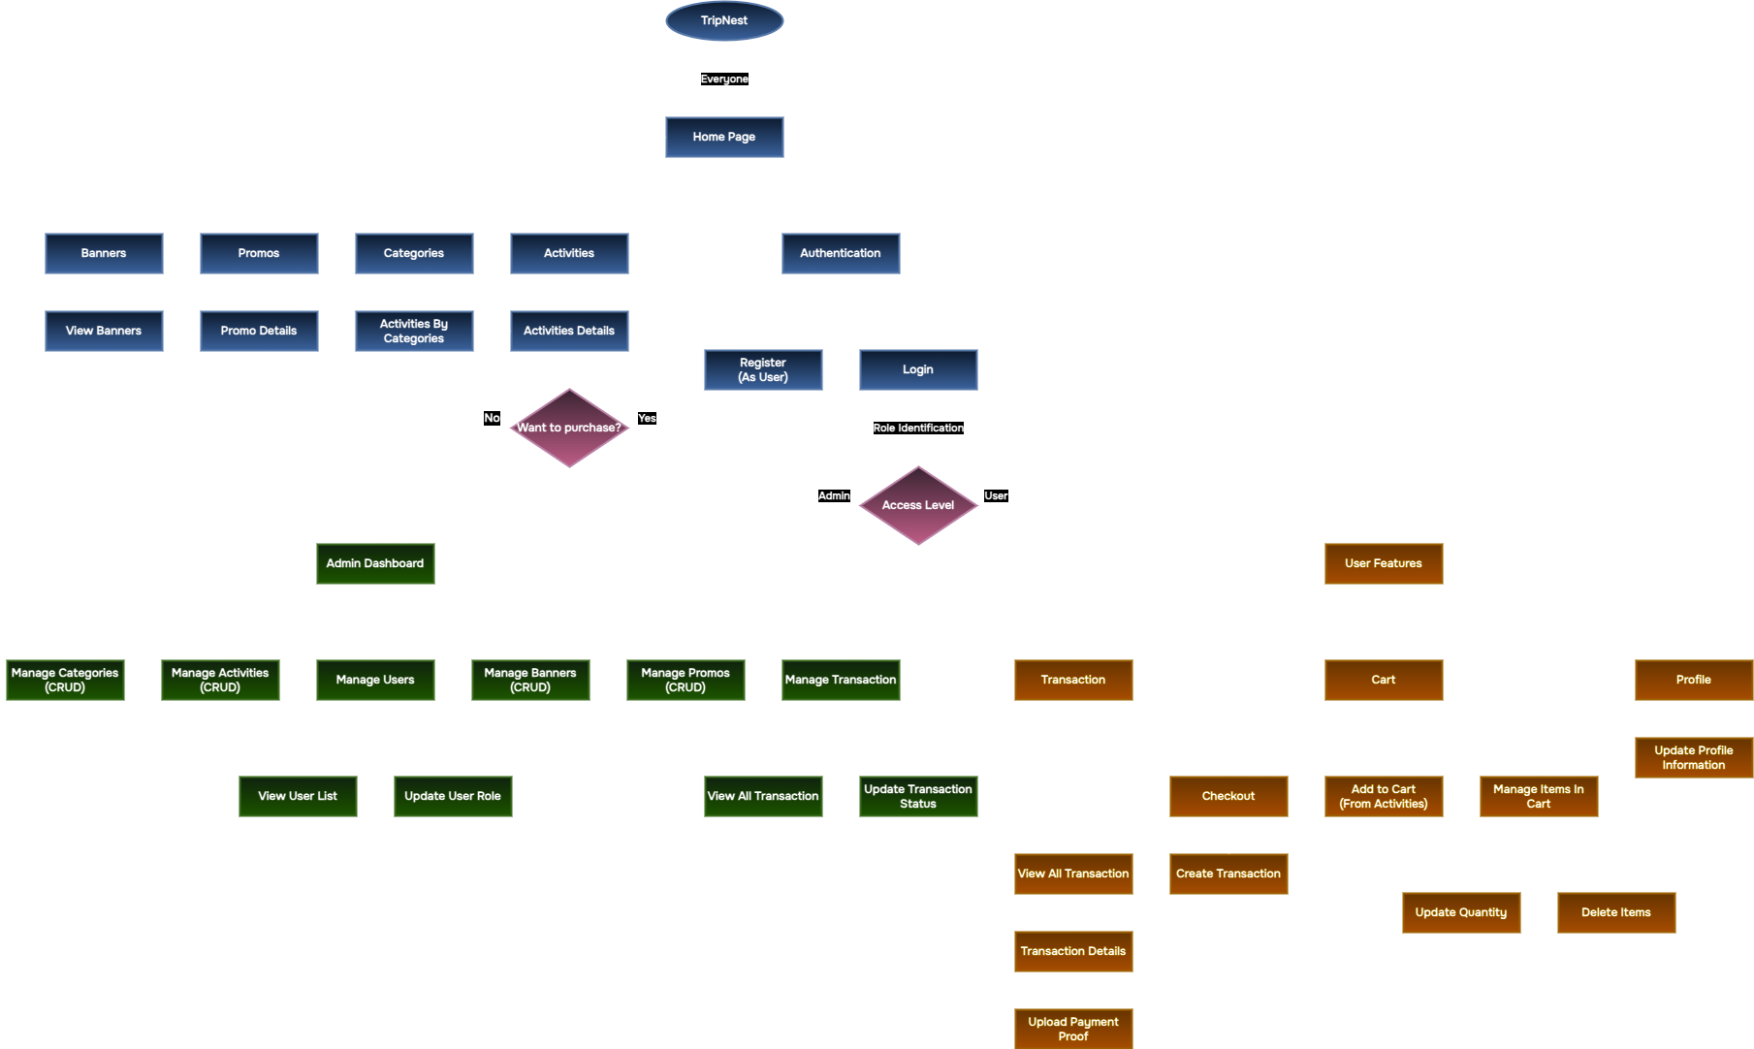
App Flow & Access Level
Blue -> Public Content, dapat diakses oleh siapapun
Orange -> User Features, hanya dapat digunakan oleh role “User”
Green -> Admin Dashboard, hanya dapat digunakan oleh role “Admin”

Slide 8
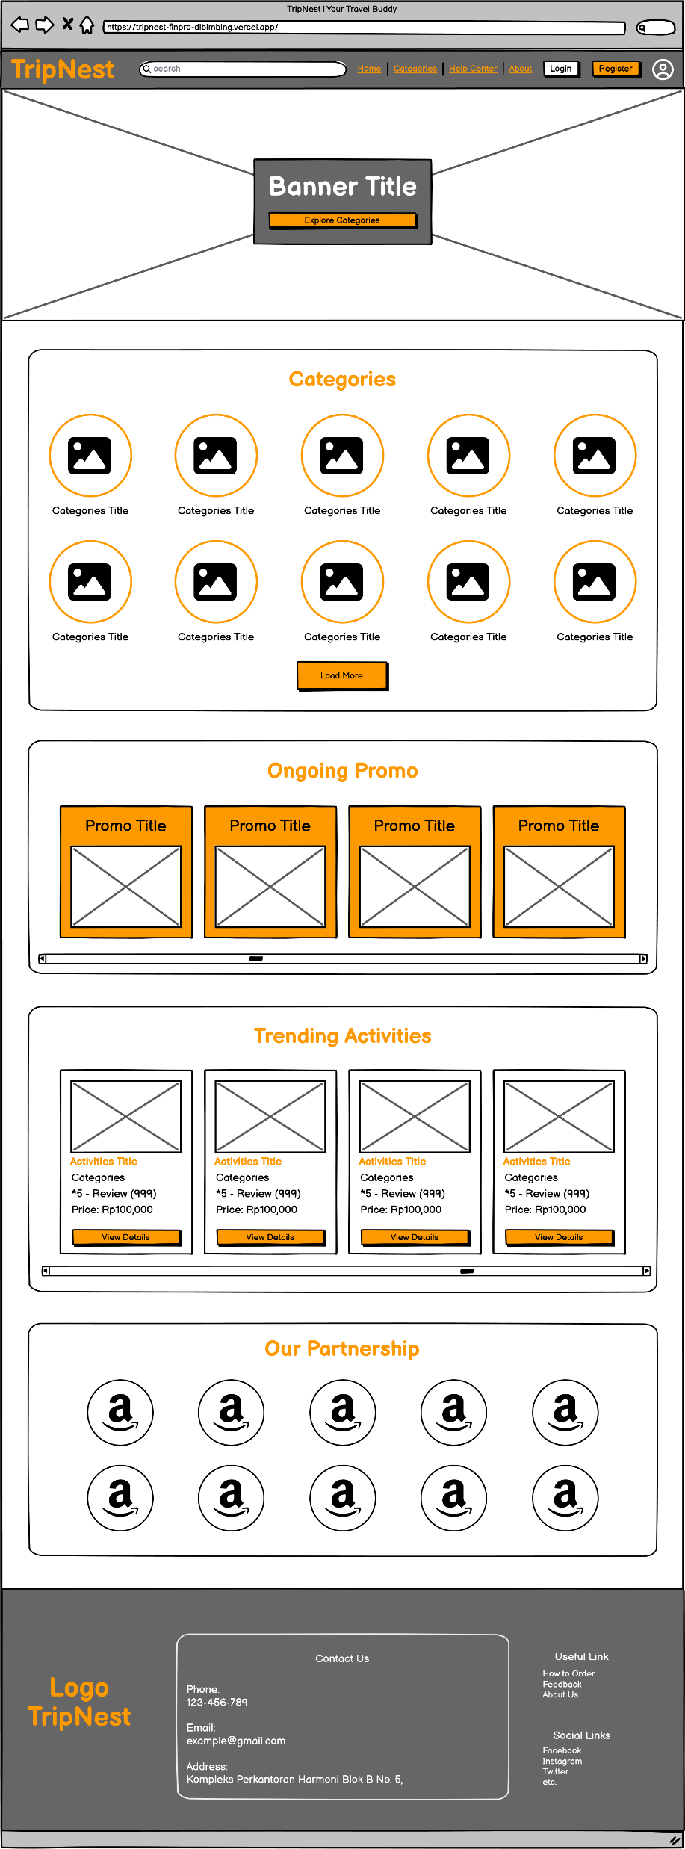
Wireframe
Landing Page

Slide 9
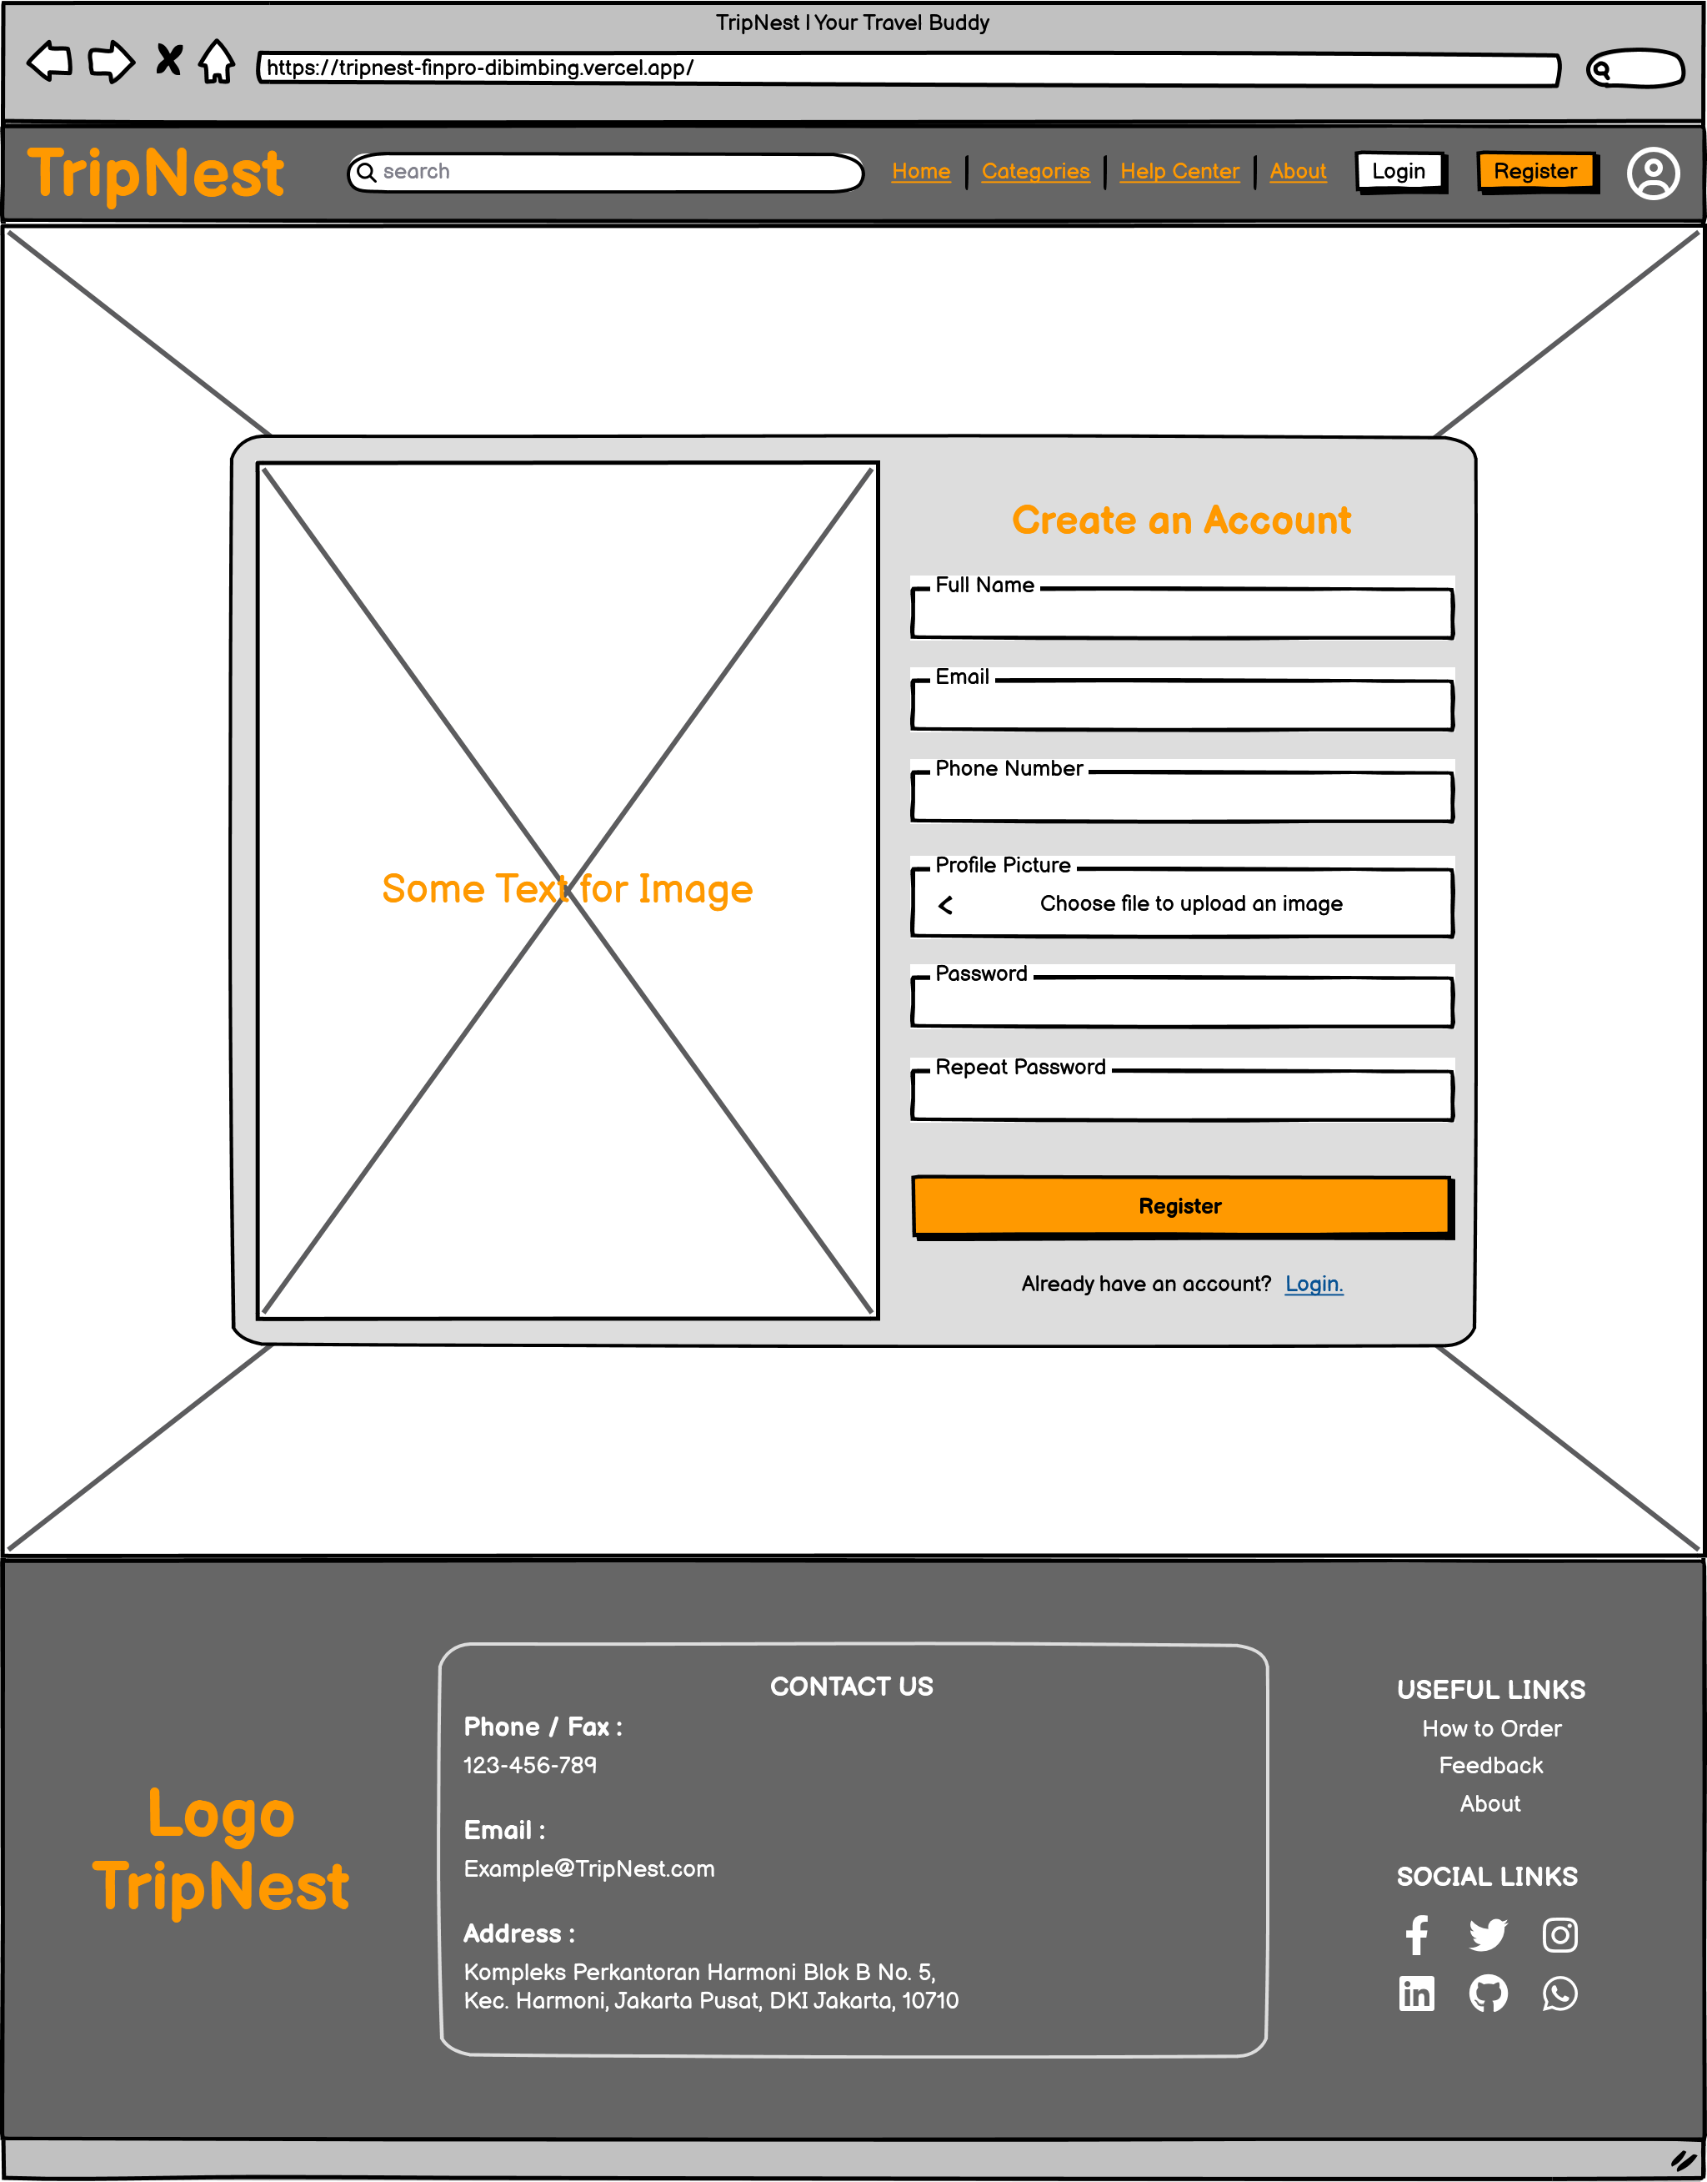
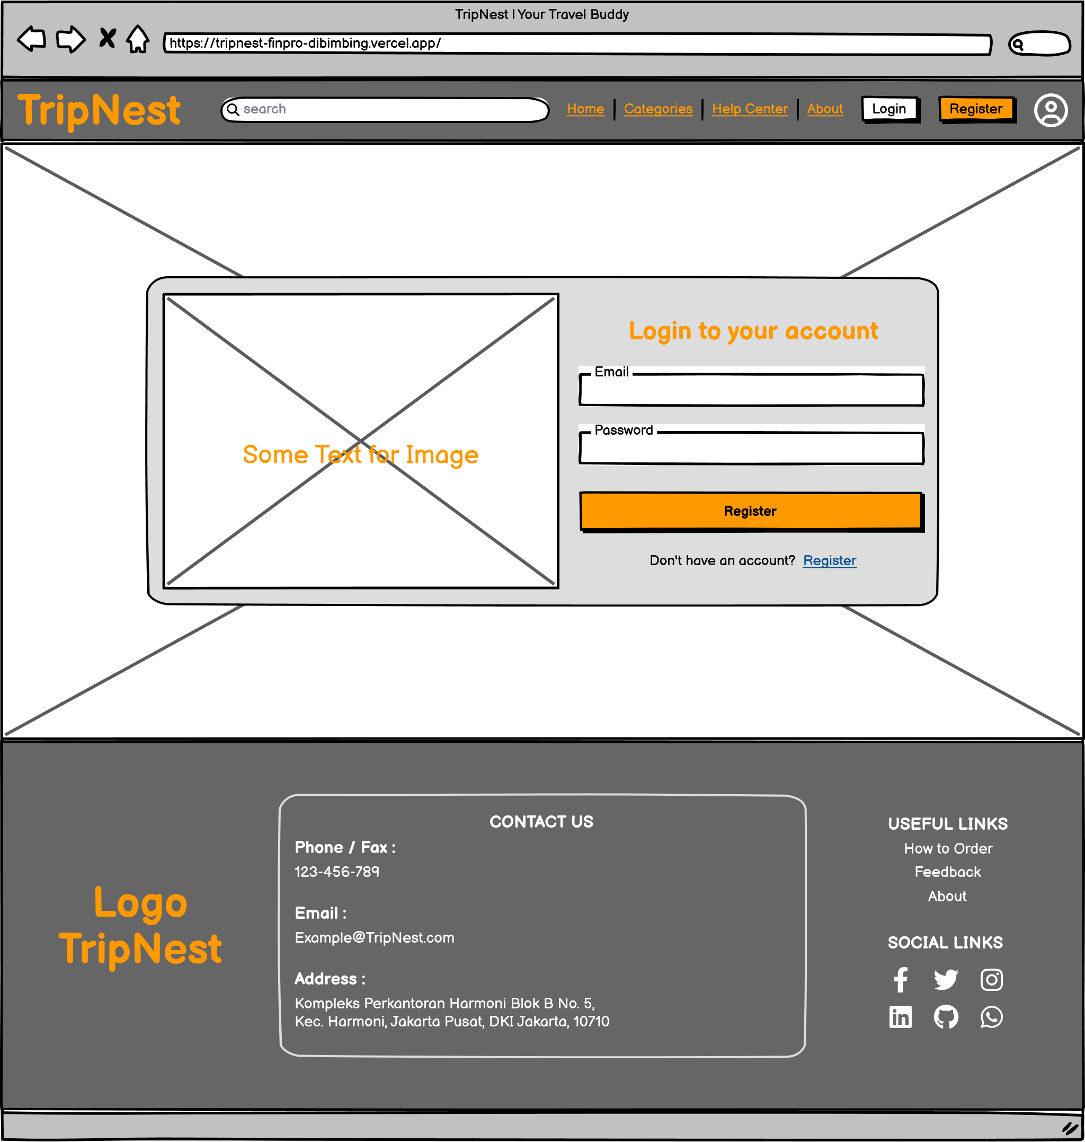
Wireframe
Authentication
Page

Slide 10
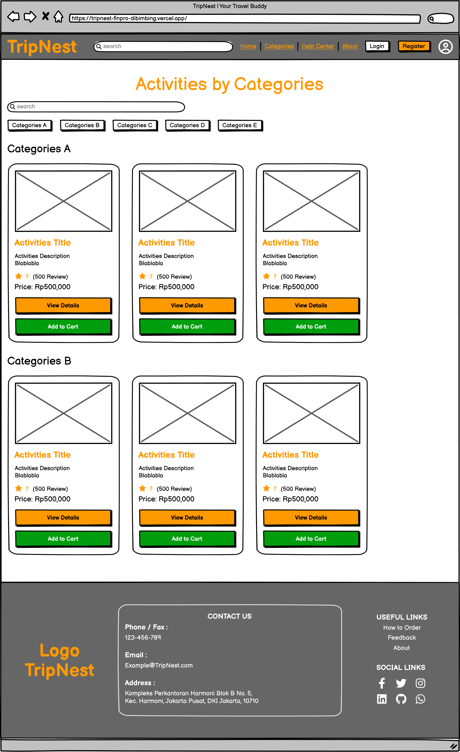
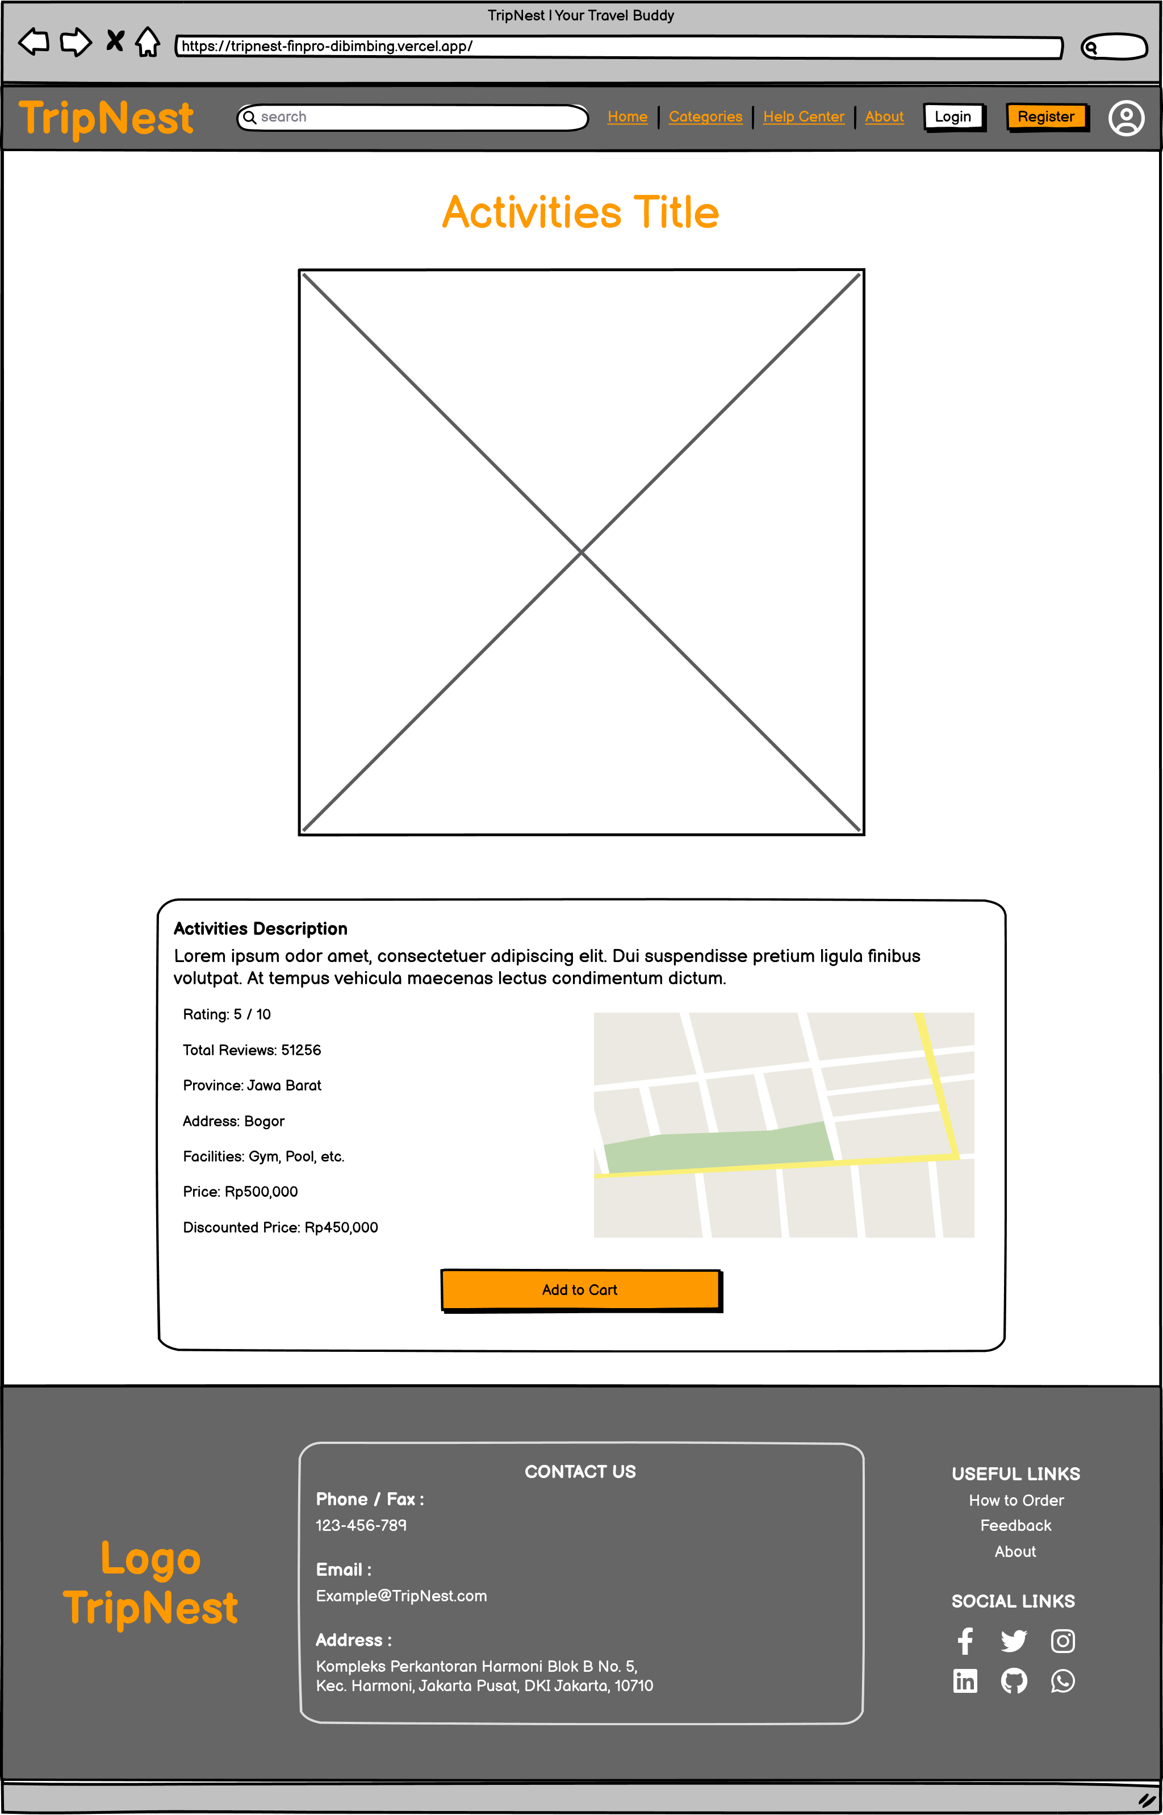
Wireframe
Categories
Page
&
Activities
Page

Slide 11
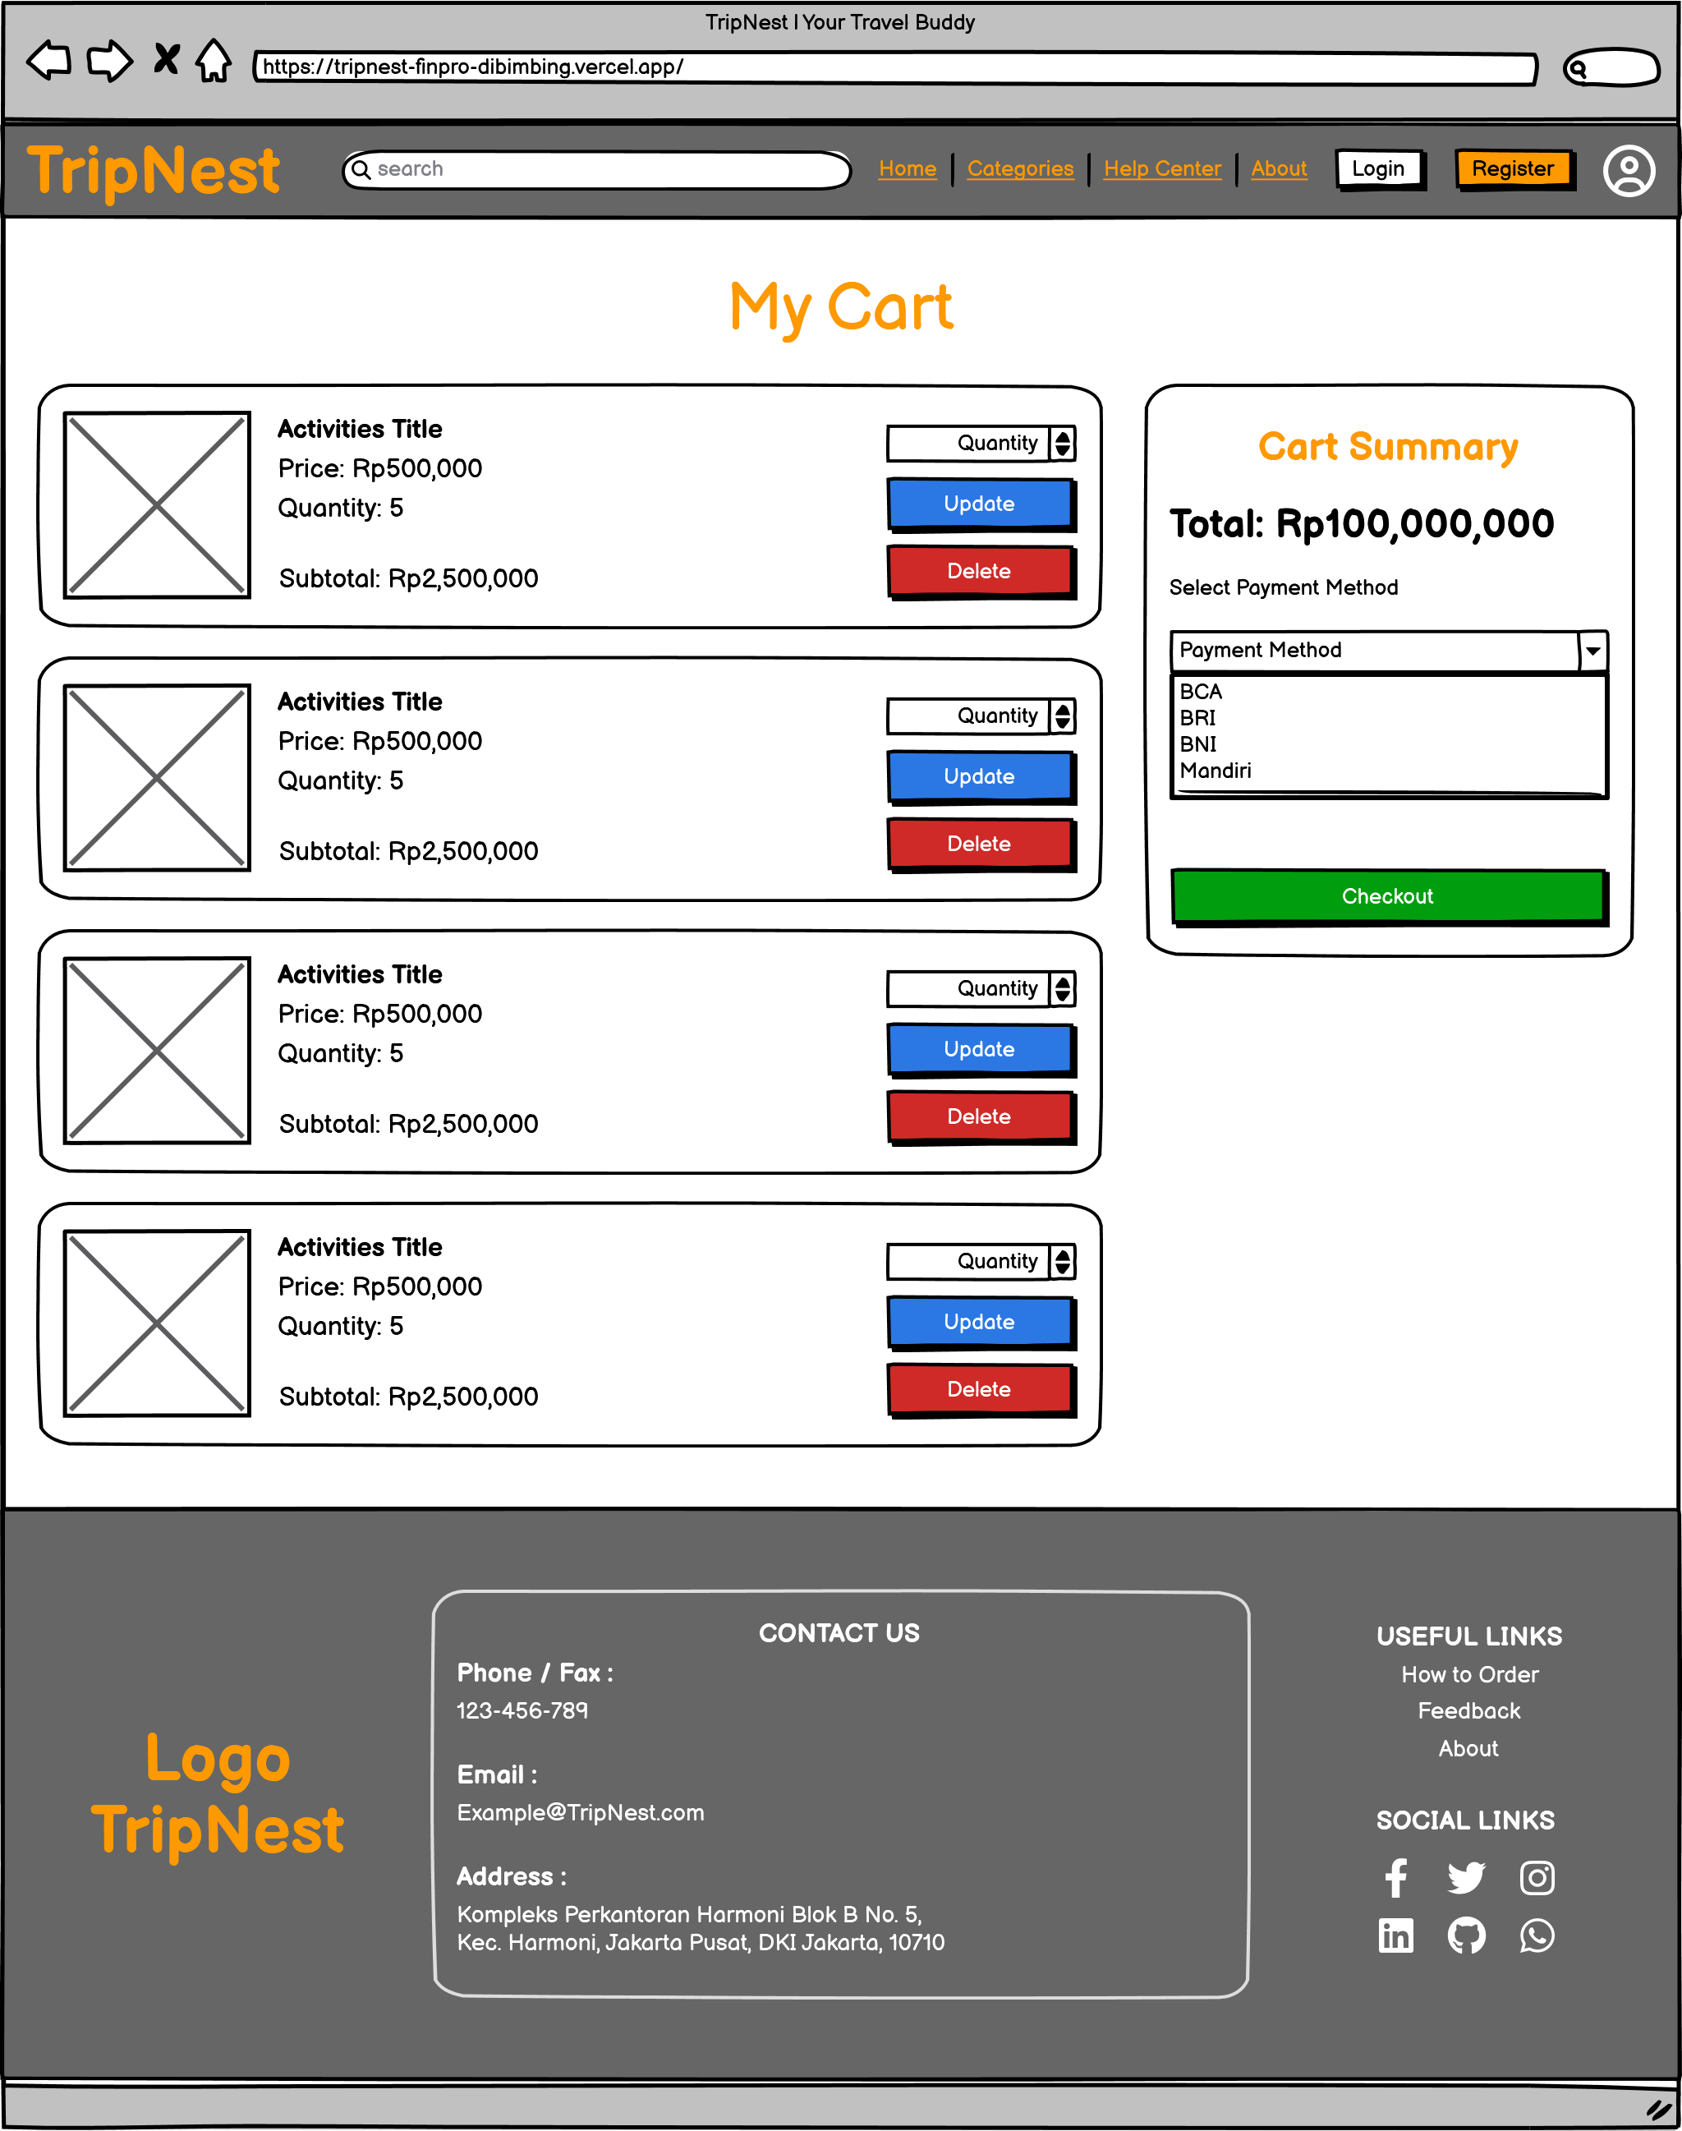
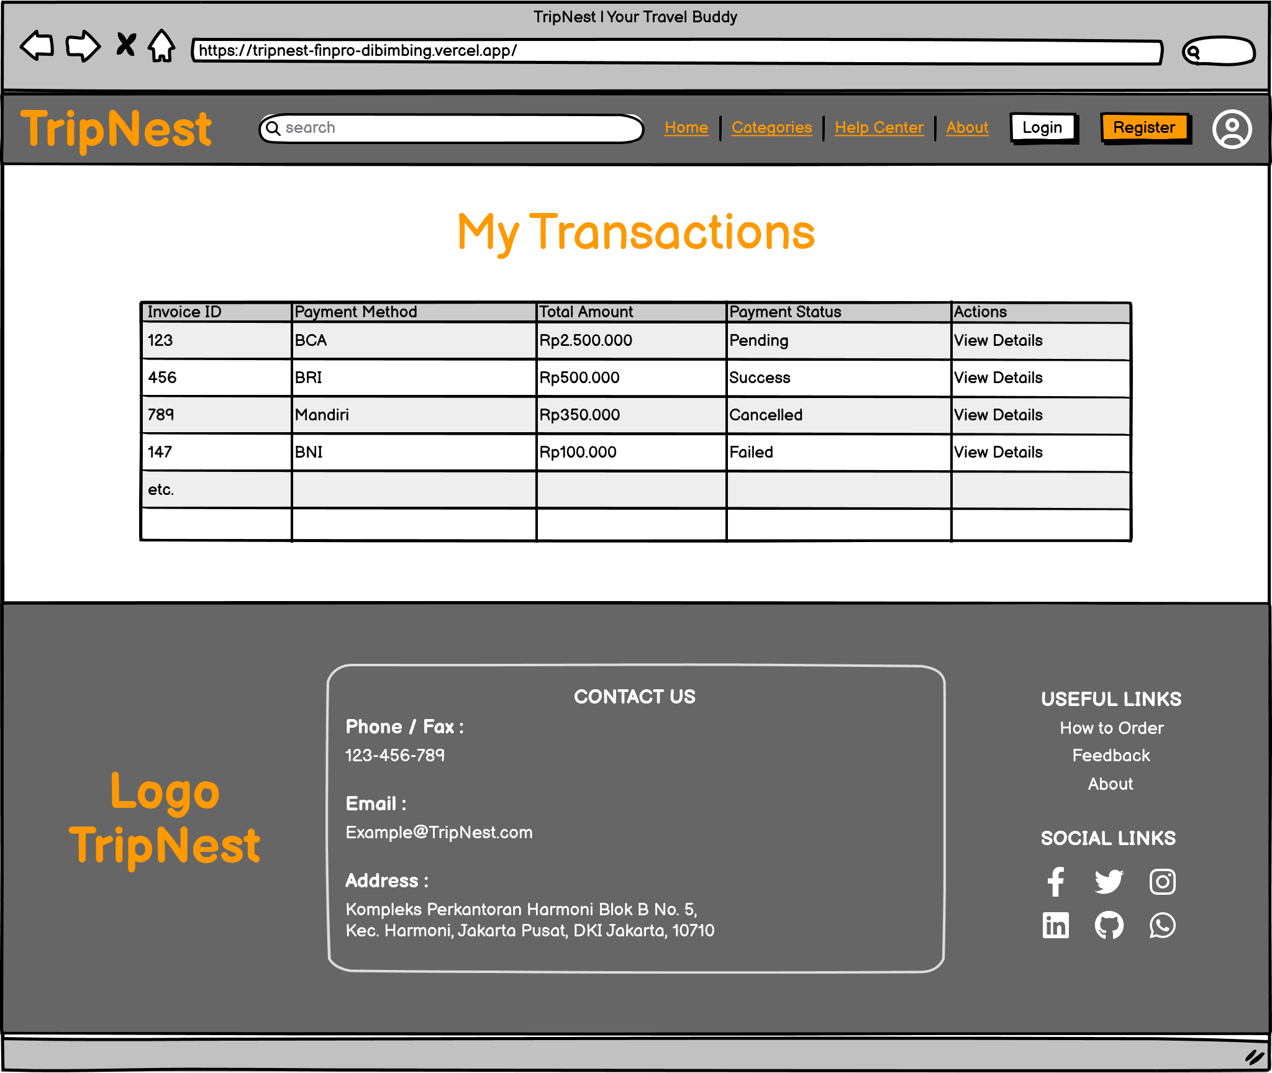
Wireframe
Cart Page
&
Transaction Page

Slide 12
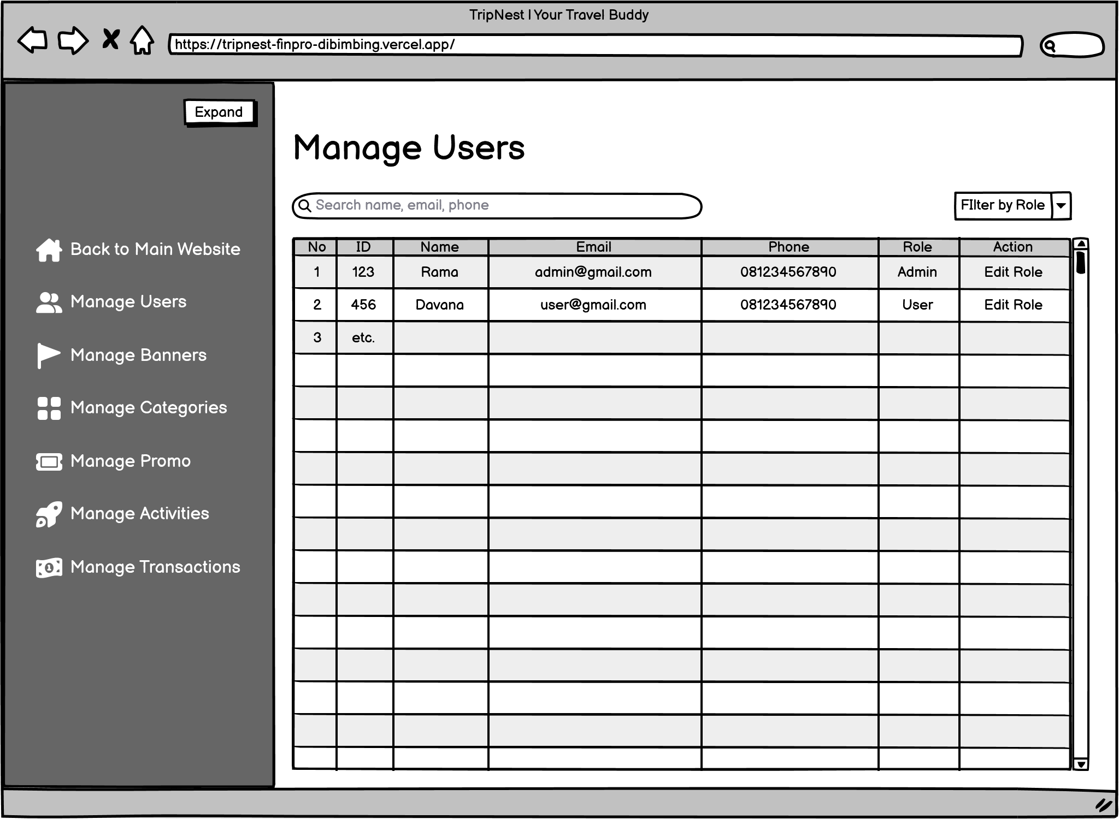
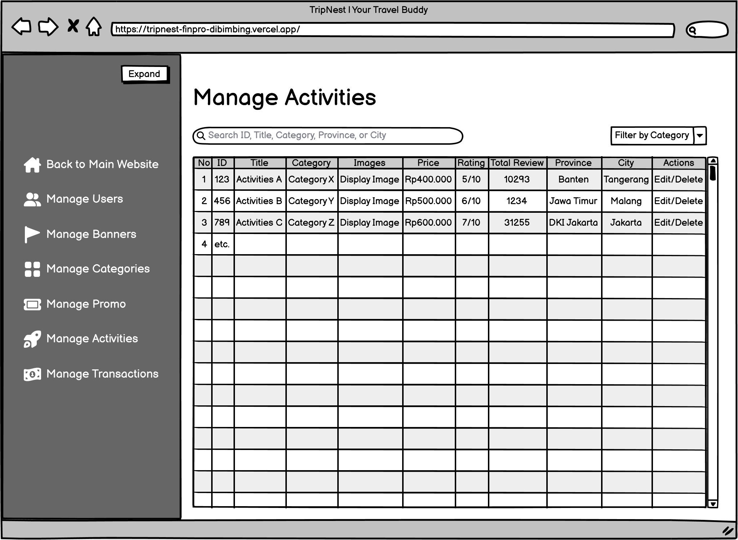
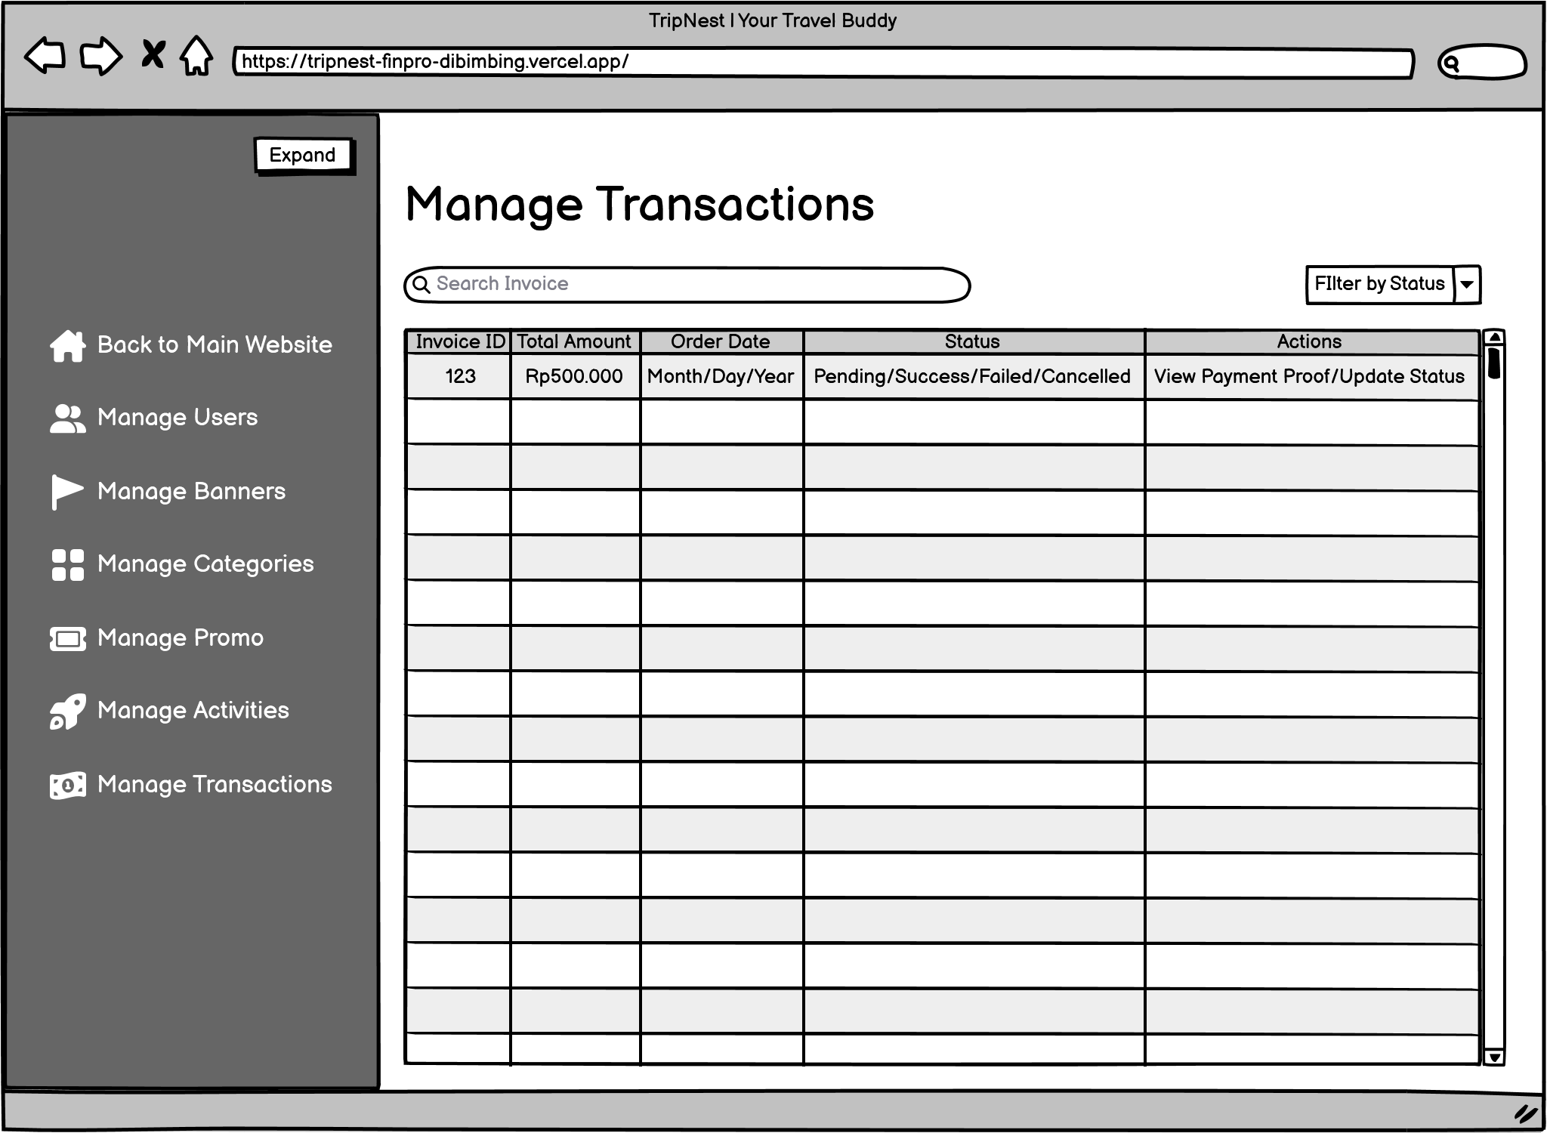
Wireframe
Admin Dashboard

Slide 13
Project Timeline
WEEK
DAY
Ideas/Concept
Understanding API
App Flow
Wireframing
Pengerjaan Project-Deployment
Week 1 |  |  |  |  |  |  | Week 2 |  |  |  |  |  |  | Week 3 |  |  |  |  |  |  | Week 4
1 | 2 | 3 | 4 | 5 | 6 | 7 | 8 | 9 | 10 | 11 | 12 | 13 | 14 | 15 | 16 | 17 | 18 | 19 | 20 | 21 | 22 | 23 | 24 | 25 | 26 | 27 | 28
Red = No Progress
Yellow = Half activities
Green = Full activities

Slide 14
Challenge & Resolver
Challenge | Resolver
Time/Deadline | Curi-curi waktu (di sela keterbatasan) Papas jam tidur (3 jam) Fokus (ingat tujuan, impian)
Bugs/Errors | Self-learning (max 3-6 jam solving) Communicate (max 1 hari respon) AI (pasti ketemu)

Slide 15
App Demo https://tripnest-finpro-dibimbing.vercel.app/ Project Deployment by Vercel (Positive Case of full-cycle activities)

Slide 16
QnA (Max 2 pertanyaan dari 2 orang)

Slide 17
End of Presentation

